Slide 1
ASSESSMENT AND MODERATION: IN PRACTICE
KEITH DAVISON
ASSESSMENTS AND CEREMONIES MANAGER

Slide 2
Assessment and moderation: unit external examiners
Assessment briefs - provide feedback on examination papers, coursework and other assessments before they are released to students
Assessment moderation - asked to provide confirmation of academic standards at assessment and unit level on the basis of a sample of student work

Slide 3
Assessment and moderation
Unit External Examiners should be confident that:
Assessments will enable students to demonstrate the achievement of the unit learning outcomes
Assessments are conducted in accordance with regulations and any professional body requirements
Assessments are set at an appropriate level
Marking by internal markers is accurate, consistent and fair
Students are fairly placed in relation to the rest of the cohort
Notes:
Re-enforce attendance during the year to meet with course team etc.

Slide 4
University guidance on moderation
Internal Moderation:
Sample is a minimum of 10% or at least 5 pieces of work
Sample contains borderline cases between each band of award classification
Sample contains an example of a first class/distinction piece of work and a clear fail
Internal moderators do not comment on individual pieces of work
Internal moderator(s) confirm moderation on SOL to confirm the range of marks.

Slide 5
University guidance on moderation
External Moderation
External Examiners do not mark work themselves or moderate disagreements between markers
External examiners review sample work and endorse that internal marking is consistent, fair and in line with national standards
External Examiners do not amend individual marks but can request further samples and exceptionally recommend amendments for full cohorts
Externals Examiners moderate work at levels 5 and above, certain exemptions apply for other units
Notes:
Re-enforce attendance during the year to meet with course team etc.

Slide 6
Assessment board process
All Unit External Examiners:
Solent must have written confirmation that the Unit External Examiner has reviewed the student work and approved the marks and unit outcomes, in order for units to be considered
You may be asked to attend Solent to view work, to access work online or a mix of both
The Schools will be encouraged for you to visit to undertake this moderation
This is in addition to your end of year report

Slide 7
Assessment board structure
Progression and Award Boards (PAB)
Confirms student progression to the next level of course or the final award
See a full profile of students results
View Extenuating Circumstances and Academic Misconduct
Outcomes
Attended by PAB External Examiner

Slide 8
Assessment board PROCESS
Progression and Award Boards
You will be informed of Assessment Board dates by Student Registry
A verbal report and endorsement of outcomes should be made at each assessment board by those attending
Report to be submitted after every board

Slide 9
Assessment CALENDAR
Mid September: assessment briefs available via our VLE (Solent Online Learning), primarily for semester 1 assessments
Mid January: assessment briefs available via our VLE, primarily for semester 2 assessments
17 June: 'main' Progression and Award Board
24 July: 'main' resit PAB
The above dates are for the standard UG provision, other boards will be held throughout the year for non-standard provision and you would be contacted as appropriate.

Slide 10
SOLENT ONLINE LEARNING (SOL)
Solent Online Learning (SOL) houses the electronic submission systems used by Solent, including links to the Turnitin system
SOL enables the submission of text-based work (40 MB), mixed format work (500 MB) and Video/audio work (1GB)
Submission links are created centrally, with dates populated via data upload where possible

Slide 11
ACCESS TO SOL
You will receive your password for SOL shortly from the Student Registry team
This password can be changed through the following URL:
https://sspr.solent.ac.uk
If your login expires or you experience problems then contact the Student Registry team on: student.registry@solent.ac.uk

Slide 12
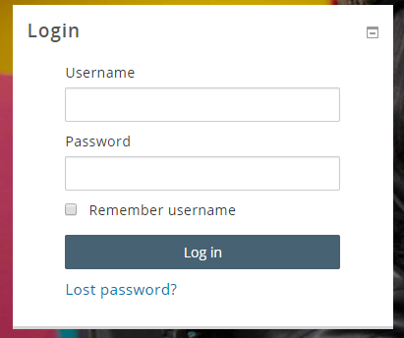
GETTING INTO SOL
To access Solent Online Learning (SOL), open an internet browser and type learn.solent.ac.uk in the address bar. This will take you to the log-in page.
Enter the username and password - press enter or click Log in.

Slide 13
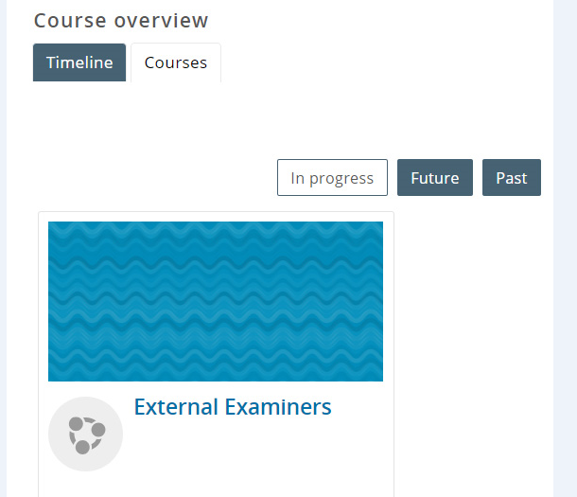
FINDING YOUR UNITS
You should already be attached to any units that you need. They will show up in the list front page. If you cannot see a unit that you think you should have access to, please get in touch with Student Registry who can add you to units.
Units will appear in the 'in progress' or 'future' tabs depending on the start and end dates of the units.

Slide 14
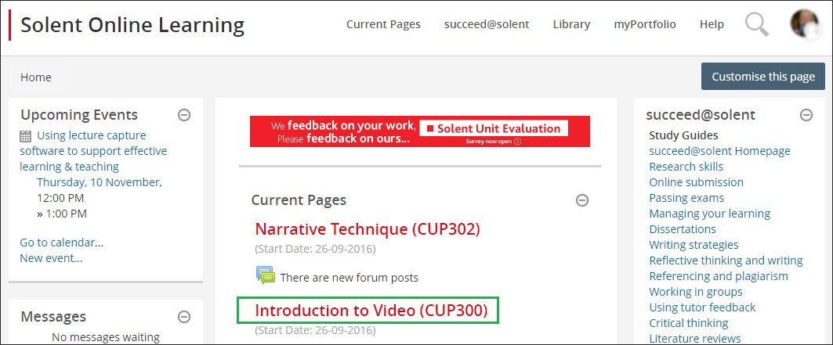
SELECT A UNIT
To visit a unit, click on its name in the list and you will be taken to it.

Slide 15
THE UNIT PAGE
The name of the unit and the unit code is in red at the top of the page. The Unit Descriptor link, if required, is directly underneath the unit name along with a number of tabs. Click on the Assessment tab and you will see the Moderation (External Examiners) Private Folder (in grey) near the top of the page.

Slide 16
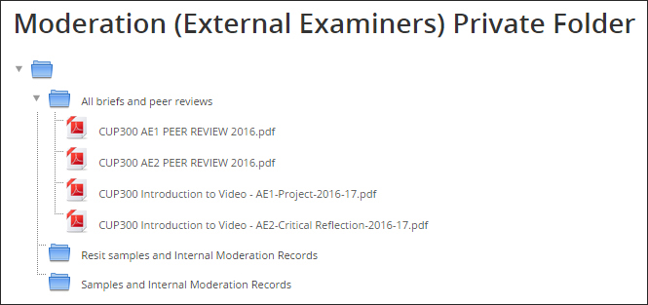
THE UNIT PAGE
This should contain resources that will help you. They are split between three folders; All briefs and peer reviews, Samples and Internal Moderation Records. For example:

Slide 17
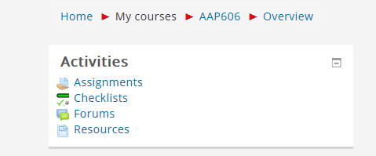
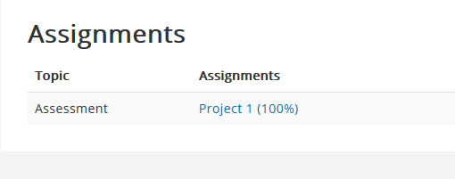
HOW TO ACCESS ASSIGNMENTS NEEDED FOR MODERATION
If the sample work has not been downloaded to the relevant blue folder then you may have been asked to look at the sample names directly.
Click on the 'Assignments' link within the relevant unit
Select the assessment

Slide 18
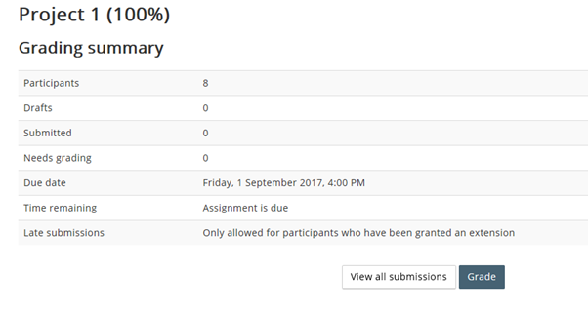
HOW TO ACCESS ASSIGNMENTS NEEDED FOR MODERATION
.
And then click on 'View all submissions'

Slide 19
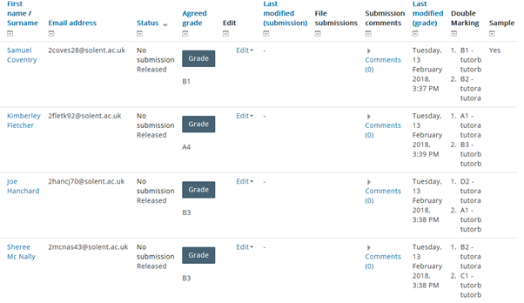
HOW TO ACCESS ASSIGNMENTS NEEDED FOR MODERATION
This will bring up the marks for that assessment, an indication of where double-marking has taken place and notification of those in the sample.

Slide 20
HOW TO ACCESS ASSIGNMENTS NEEDED FOR MODERATION
If a unit is not subject to double-marking then this field is removed.
At the point of submission, only the unit leader can submit the grades and confirm that the mark has followed University protocols.
Once marks have been submitted the tutors will see this message at the top of the results screen to show that these marks cannot be further amended and have been pushed into our results database.

Slide 21
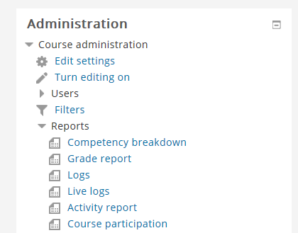
HOW TO ACCESS ASSIGNMENTS NEEDED FOR MODERATION
In addition, marks can be seen through SOL but in an alternative format if desired. Find the unit as usual, then select Reports then Grade report located through the Administration block, normally located on the left-hand side of the page.

Slide 22
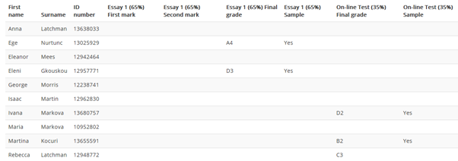
HOW TO ACCESS ASSIGNMENTS NEEDED FOR MODERATION
This brings up the list of marks for the WHOLE unit, indicating 1st and 2nd marking where double-marking has occurred, agreed assessment marks and the indication of those part of the sample.
This report can be printed if required.
Solent University External Examiners’ Briefing Day 2018

Slide 23
HOW TO ACCESS ASSIGNMENTS NEEDED FOR MODERATION
The samples of work can be viewed either with the SOL page, alongside the marks, etc or by clicking the sample link on the grade report

Slide 24
CONFIRMING MODERATION
Once you are satisfied of the marking standards of a particular assessment then please complete and return the available ‘External Examiner Sample Feedback’ form.

Slide 25
FEEDBACK FORM

Slide 26
HELP!
If you need any assistance then contact Student Registry via student.registry@solent.ac.uk or contacting us on 02382 015 023.
Any questions?

