Slide 1
Building an excellent university
Professor Graham Baldwin
Vice-chancellor

Slide 2
Solent university
160 years of history
An international University
We deliver graduates with the right skills and experience for employers
Over 11,000 students study degrees from over 100 nationalities
More than 10,000 additional student complete their CPD at Solent
Leaders in apprenticeships and accelerated deliver
Spanning industries from fashion to engineering, across five academic schools

Slide 3
MISSION
The pursuit of excellent university education that enables learners from all backgrounds to become enterprising citizens and responsible leaders whilst promoting economic and social prosperity for all the communities we serve.

Slide 4
VISION
An inclusive university which is a catalyst for social justice, social mobility and economic prosperity by providing access to top-class university education for all those qualified and able to benefit.
An outstanding student experience characterised by the highest quality engagement and intellectual challenge which develops self-confidence thus enhancing career and life prospects
Vibrant and successful, known nationally and internationally for the excellence of its learning and teaching and for its sector leading integration of theory and practice
Research active and informed with areas of world leading activity underpinning key and distinctive curriculum areas in support of ‘real world’ learning.
The applied University for Southampton and the Solent region, with accelerating national and international influence, enabled by imaginative partnerships at home and abroad.

Slide 5
PEOPLE EXPERIENCE
LEARNING AND TEACHING |  | RESEARCH AND INNOVATION |  | STUDENT ACHIEVEMENT |  | INTERNATIONALISATION
RECRUITMENT |  |  |  | REPUTATION

Slide 6
OUR FIVE ACADEMIC SCHOOLS

Slide 7
OUR EAST PARK CAMPUS

Slide 8
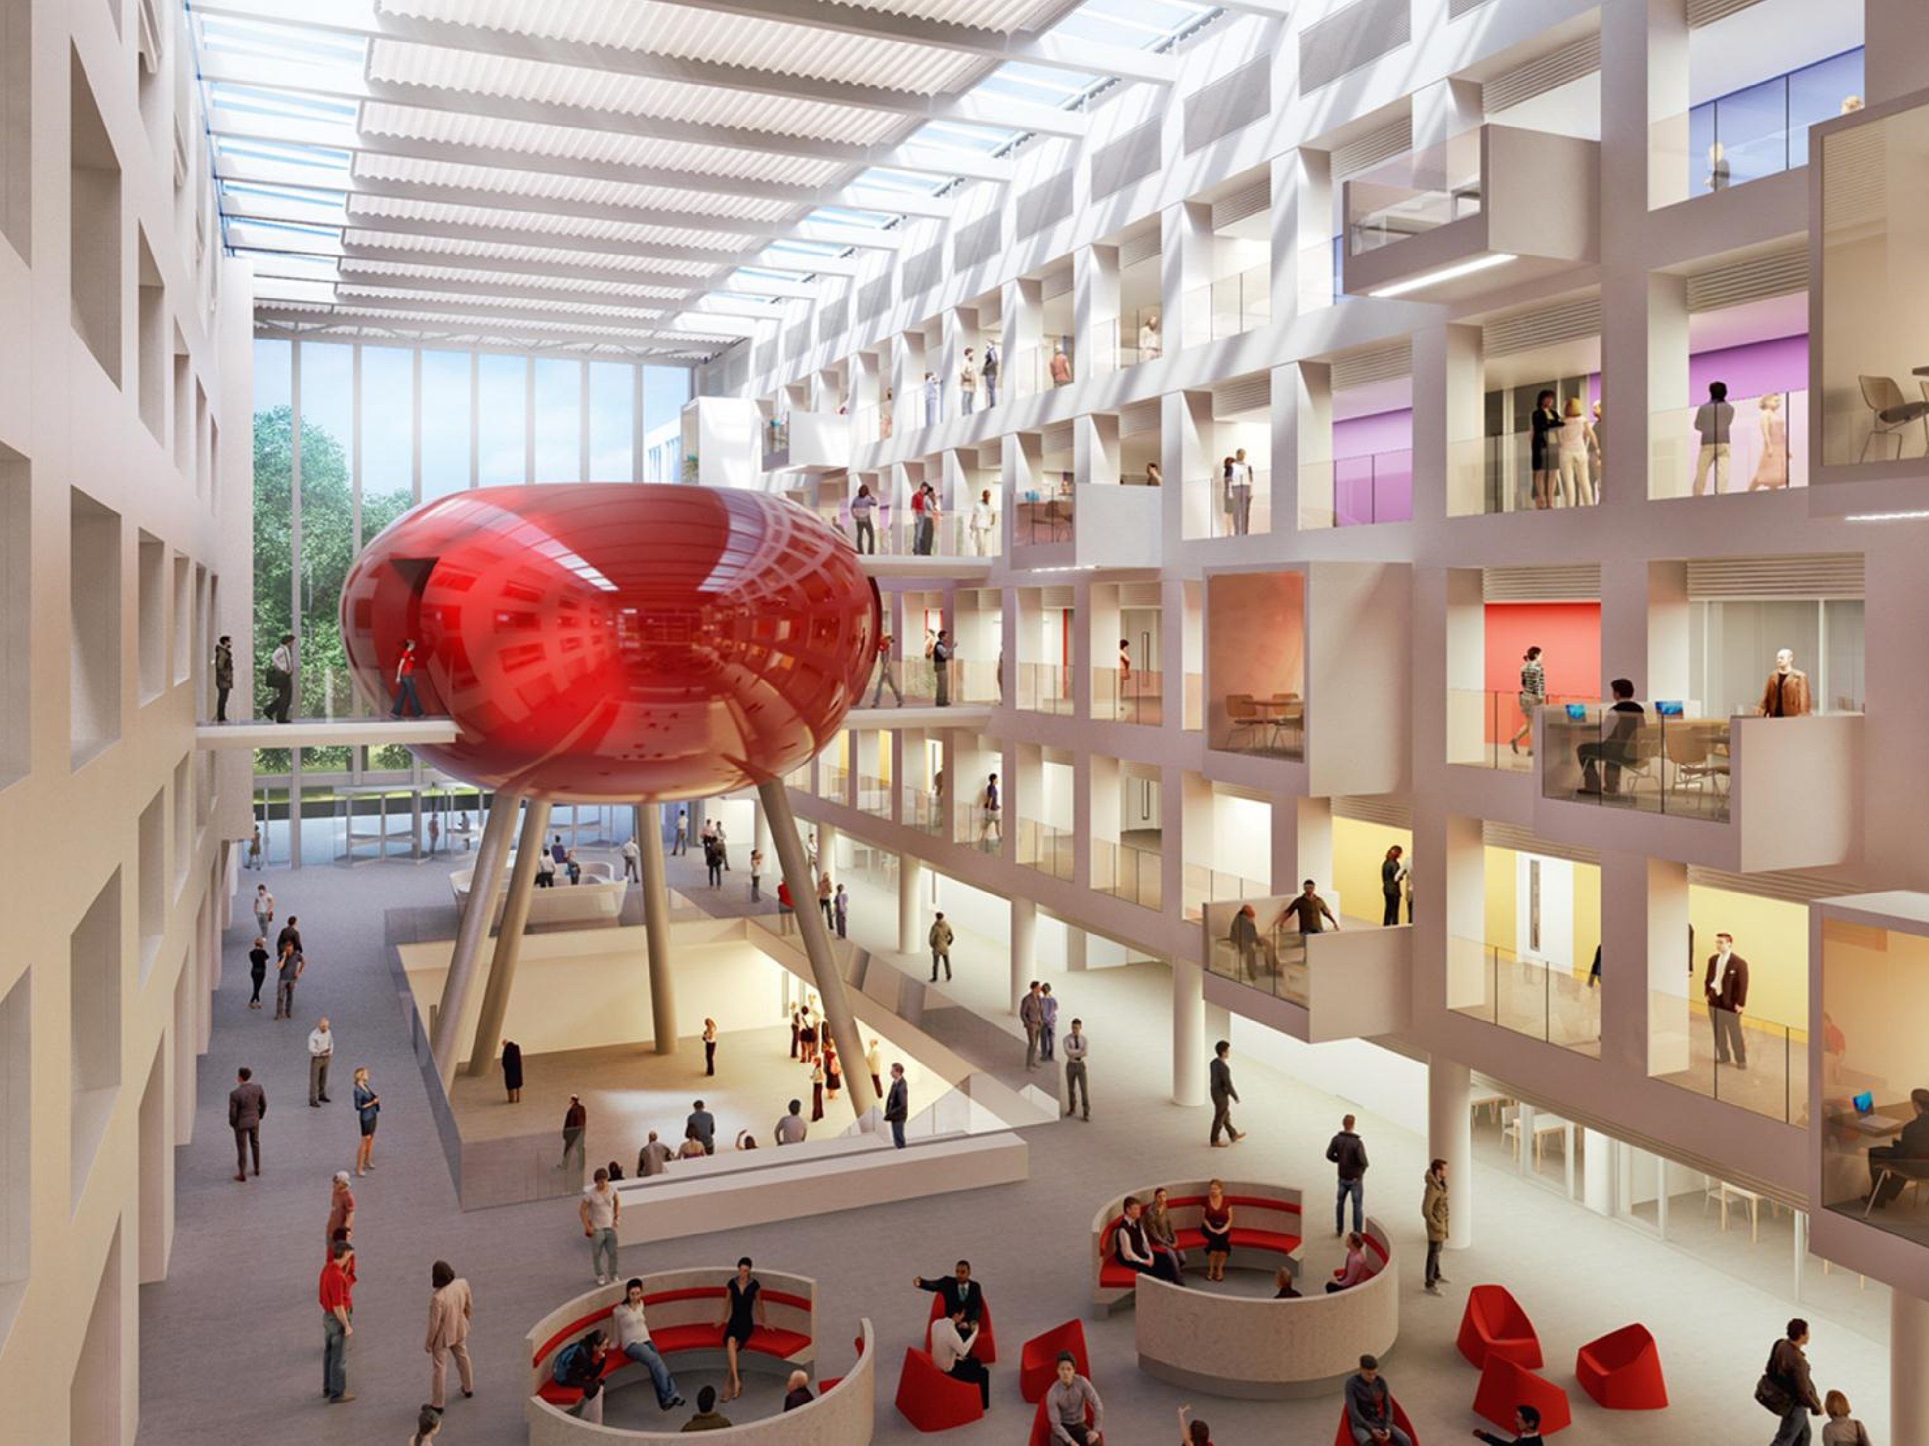
THE SPARK
Our new £33million teaching and learning facility, also housing our Conference Centre

Slide 9
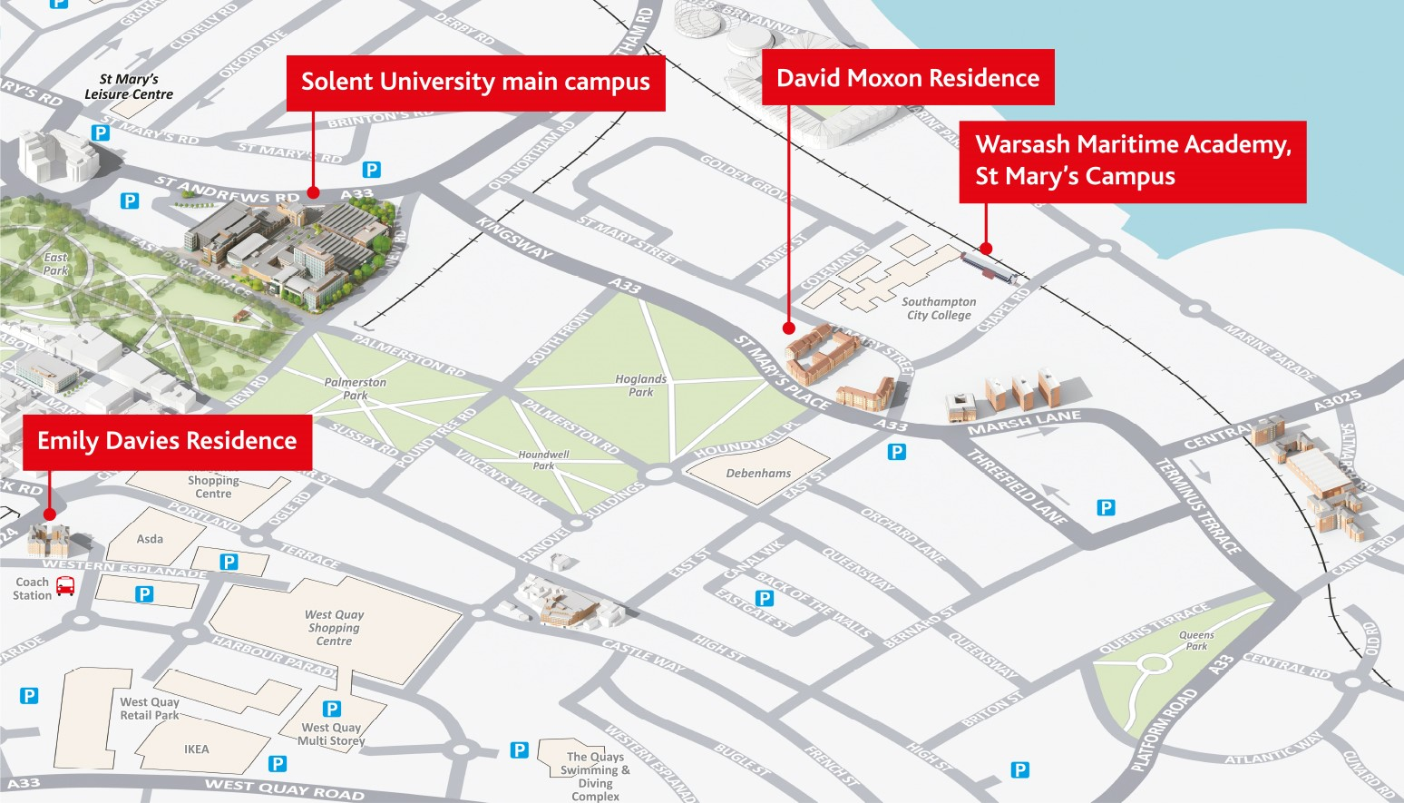
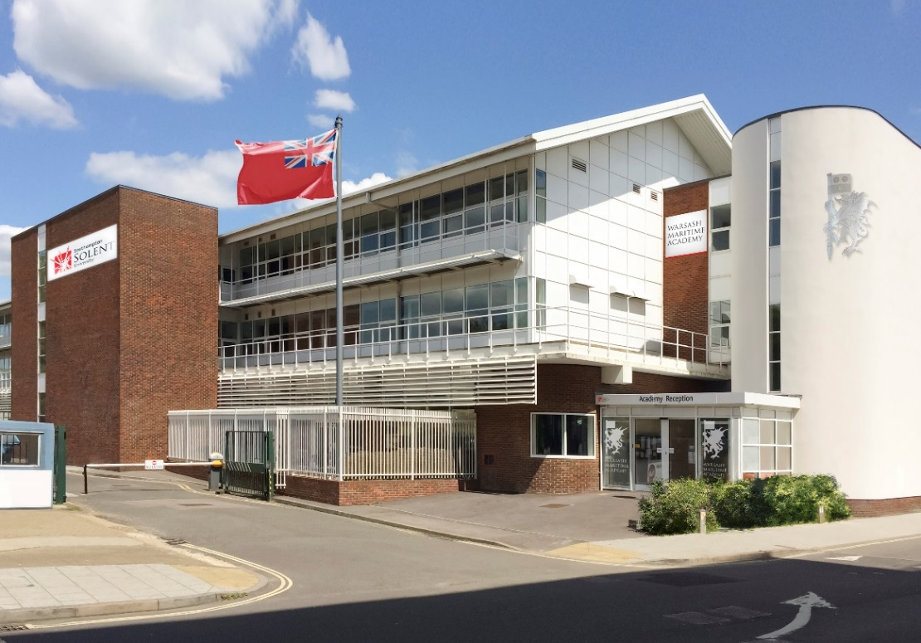
OUR ST MARY’S CAMPUS

Slide 10
BUSINESS, LAW AND COMMUNICATIONS
at Above Bar
ART AND DESIGN
at Below Bar

Slide 11
TEST PARK
sports and teaching facilities

Slide 12
OUR WARSASH CAMPUS

Slide 13
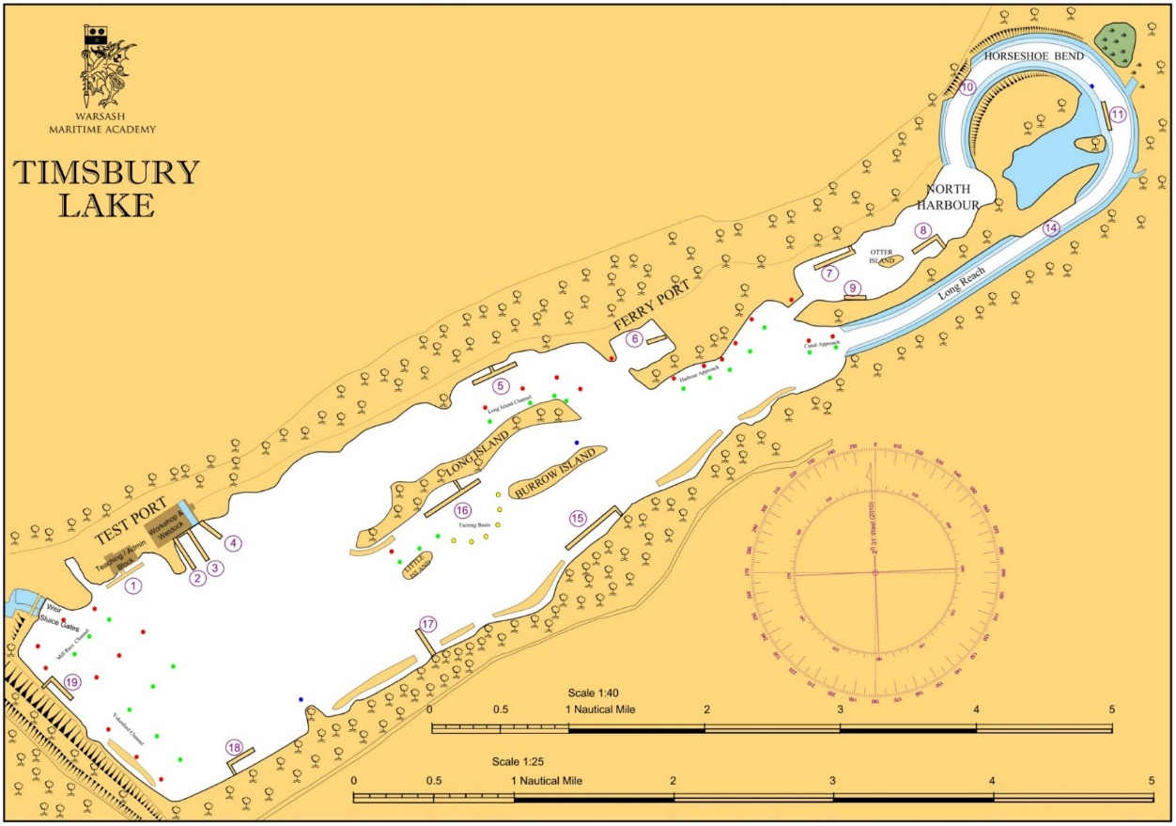
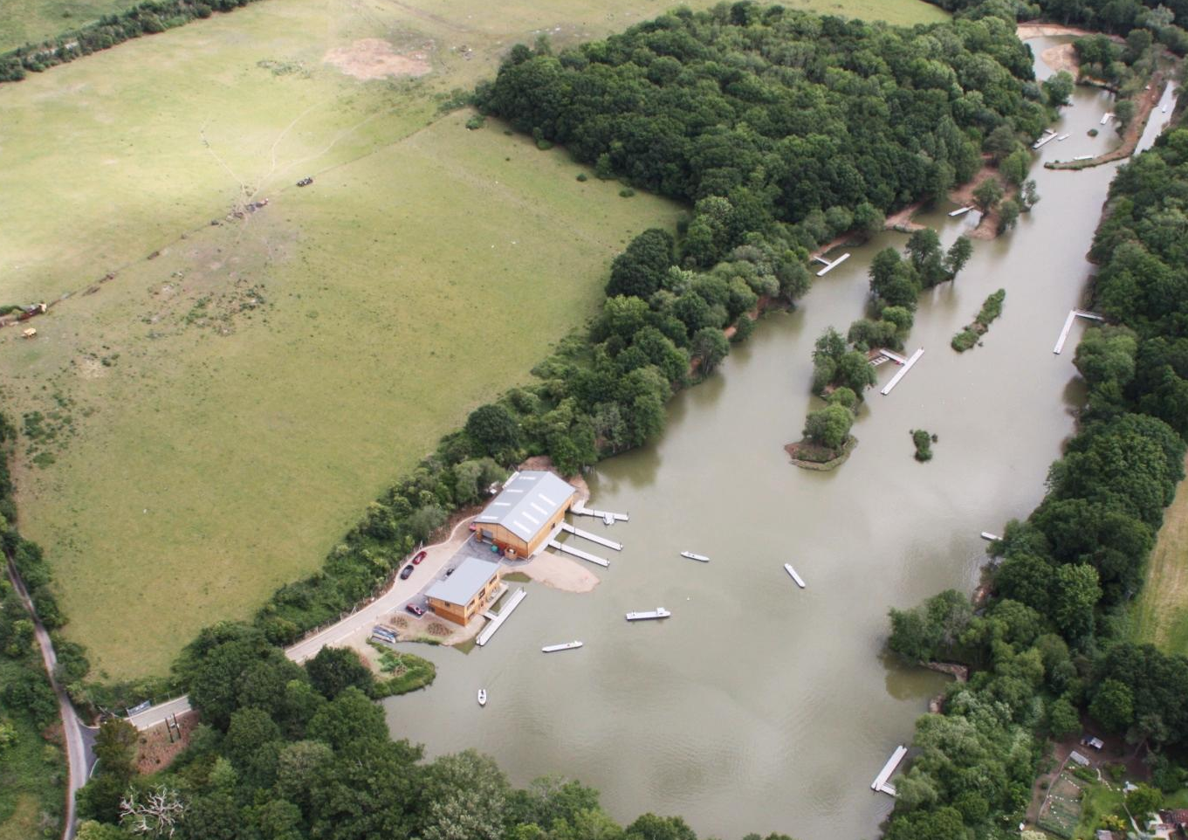
TIMSBURY LAKE
a man-made lake training facility and ship handling centre

Slide 14
CONNECTED TO BUSINESS
Notes:
Re-enforce attendance during the year to meet with course team etc.

Slide 15
ACCREDITED TO MEET INDUSTRY STANDARDS

Slide 16
WE’RE CREATIVE
Voted one of the most creative universities in the UK by Which? University student poll 2013 and 2014
Retail Solent (Re:So)
We have our own innovative media agency and production house, Solent Creatives, Solent Productions as well as student led fashion retailer, Re:So
Solent TV studio
Outstanding facilities including our outside broadcast vehicle, media academy and 3D cinema with Dolby-certified studio facility

Slide 17
A LEADING MARITIME PROVIDER
Warsash School of Maritime Science and Engineering is one of the world’s premier maritime, education, training and research centres
Working with global shipping companies including Maersk, BP International Ltd and Carnival
Launched Warsash Superyacht Academy in 2012 and opened our St Mary’s Campus in 2017.
Providing premier professionals to the global superyacht sector

Slide 18
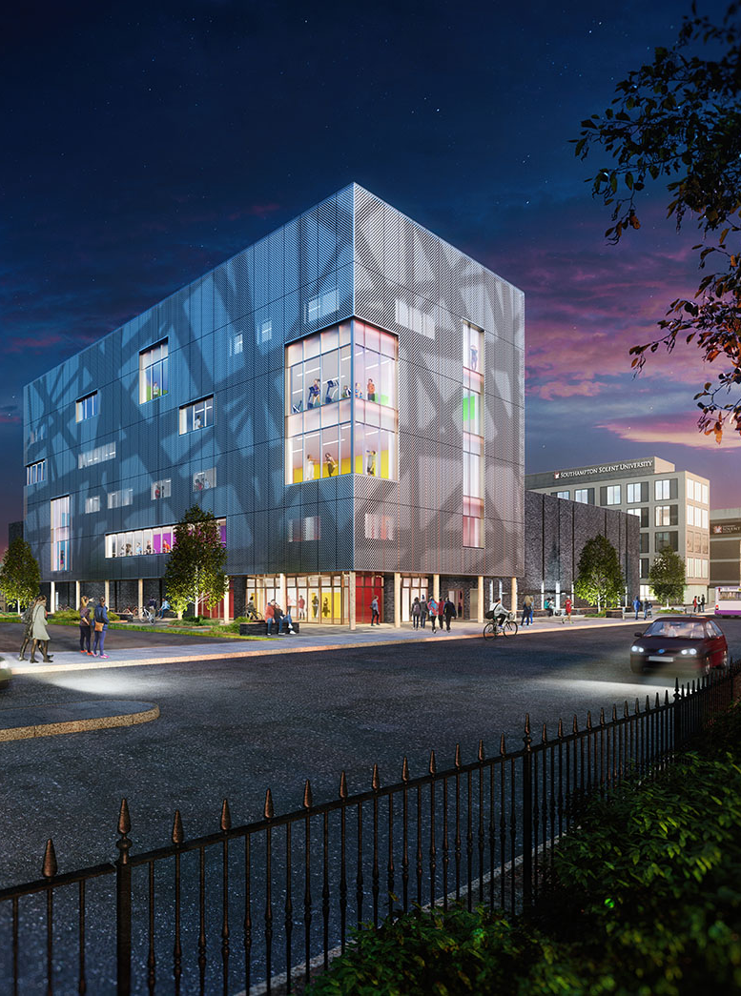
A LEADING Health, Sport and social science PROVIDER
Our new £28m Sports Building is due to open in 2019
Approved by the Nursing and Midwifery Council for nurse provision including degree apprenticeships and BSc degrees – 2018
Other accreditations include the Association for Nutrition, British Psychology Society, British Association of Sport and Exercise Science.
New provision in nursing, biomedical science, nutritional sciences, sociology – from next year

Slide 19
NATIONAL STUDENT SURVEY (NSS) The University’s scores increased in eight of the nine survey areas that were comparable to 2017. Overall satisfaction in the sector decreased whilst Solent increased its score to 83%, our highest ever achieved score. The overall response rate at University level was 80%, also our highest ever. The LTSAC will receive a full analysis of results. An NSS monitoring group will continue to develop a structured enhancement and intervention plan.

Slide 20
NATIONAL STUDENT SURVEY (NSS)
The University’s scores increased from 2017 in eight of the nine survey areas and are higher than the sector average in six survey areas (‘Learning opportunities’, ‘Assessment and feedback’, ‘Academic support’, ‘Learning resources’, ‘Learning community’ and ‘Student voice’) and equal to the sector in two areas (‘Teaching’ and ‘Overall satisfaction’).
Notes:
Re-enforce attendance during the year to meet with course team etc.

Slide 21
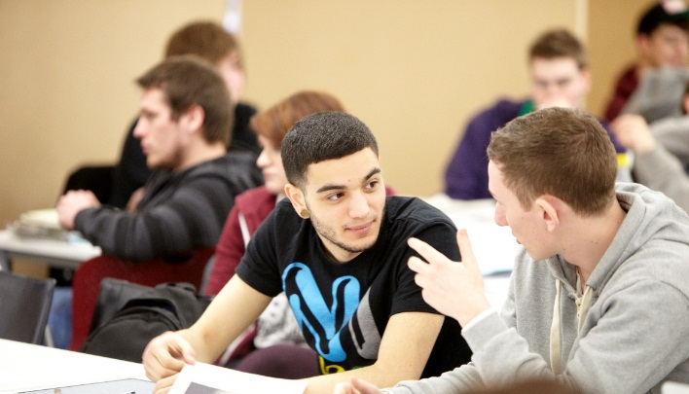
WE’RE INCLUSIVE AND STUDENT FOCUSED
At Solent, higher education is available to all who can succeed
Solent University is welcoming and accessible for all students and staff
The Student Hub offers a single point of contact for specialist services to students to support their studies

