Slide 1



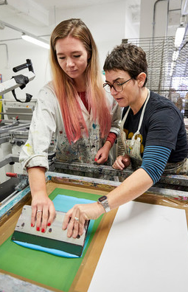





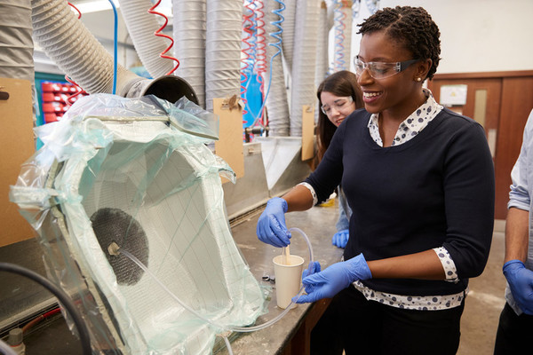
ONLINE OPEN DAYs
BOOK now: solent.ac.uk/open-days
DATE: | ONLINE OPEN DAY FOR:
Saturday 24 April | Warsash Maritime School - Virtual
Saturday 5 June | All faculties (not Warsash Maritime School) - Virtual
Saturday 12 June | Warsash Maritime School - Virtual
Saturday 10 July | All faculties (not Warsash Maritime School) – On campus

